Slide 1
Input-Output Analysis – Introduction
Thomas Gibon
LIST
November 7th 2024

Slide 2
Agenda
01
Input-output analysis
02
Environmental extensions
03
Multi-regional tables (and EXIOBASE)
04
Examples of applications

Slide 3
01|Input-Output Tables

Slide 4
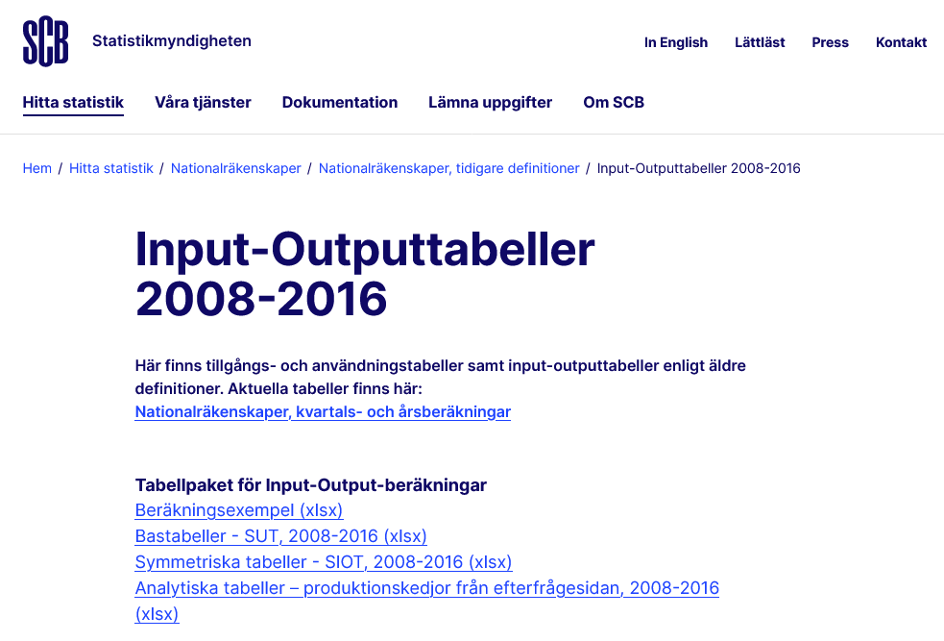
“Input-output” analysis?
Overview
Input-output analysis is an accounting procedure that is based on “input-output (IO) tables” IO tables provide...
… the total output of an industry … what is sold by an industry to other sectors (and to its own) and its "inputs" … what is purchased by an industry in order to manufacture its products and services (imagine a cooking recipe)
Every country regularly publishes IO data
https://www.scb.se/hitta-statistik/statistik-efter-amne/nationalrakenskaper/nationalrakenskaper/nationalrakenskaper-tidigare-definitioner/pong/tabell-och-diagram/input-outputtabeller-2008-2016/

Slide 5
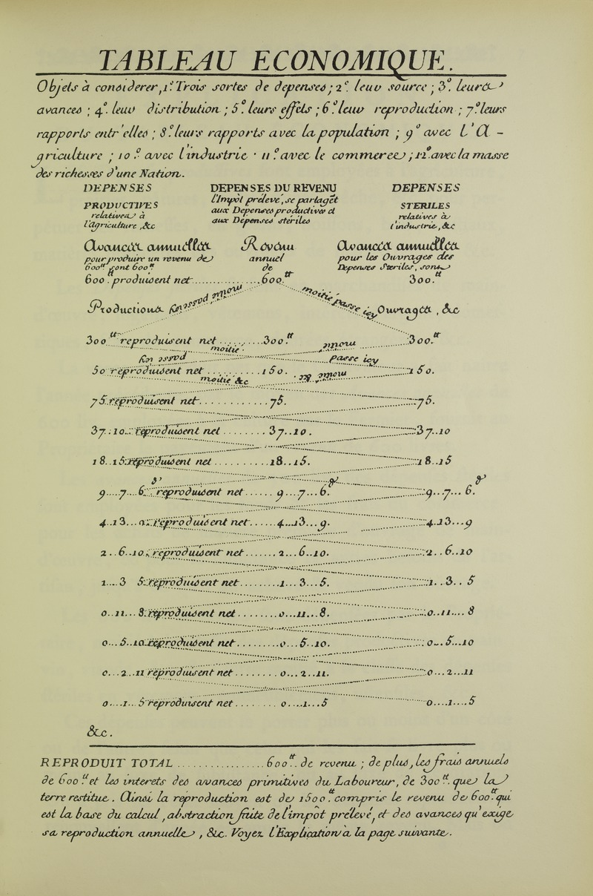
Brief history of input-output analysis
1758: François Quesnay’s “Tableau économique”
Published in 1758, it is the first abstract representation of the flows of trade and production within an economy
This version is very focused on agriculture (industry is very poorly represented)
This is the first time that the problem of the "infinite" value chain has emerged, where two interdependent sectors exchange products

Slide 6
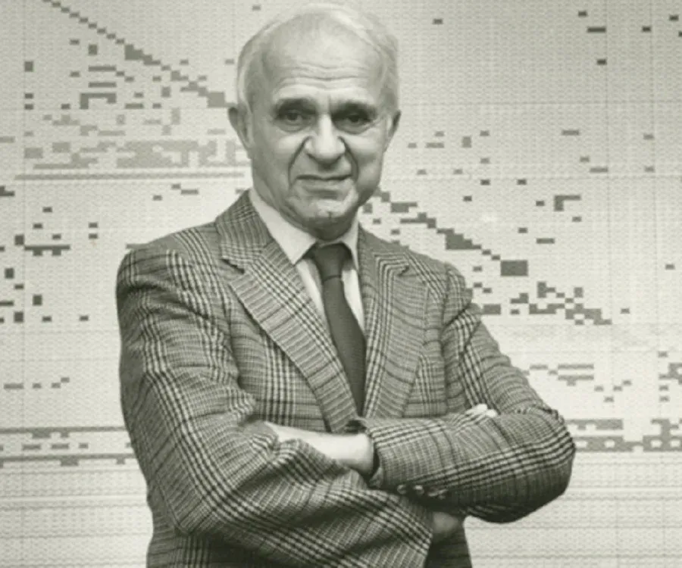
Brief history of input-output analysis
1973: Wassily Leontief receives the Nobel Prize in Economics
Wassily Leontief has taken up the approach of François Quesnay and his "economic table" to construct "input-output tables".
These tables make it possible to visualize and then analyze the relationships between the industries of an economy.
Thus, they establish a link between the factors of production (labour, capital, etc.), the intermediate products exchanged by industries and the finished products.
Leontief’s input-output model explicitly takes into account the general interdependence of all economic sectors.
By taking fairly strong hypotheses (which we will see later), Leontief was able to obtain a model that links the intermediate and final production of the different goods.
https://www.economie.gouv.fr/facileco/wassily-leontief

Slide 7







What do IO tables look like?
Representation of interactions between sectors of the economy
0.5
10
0.5 |  |  | 7 | 5
10 |  | 3
 |  | 1
 | 6 |  |  | 1
 |  | 2
5 | 4
2
5
1
3
7
6
5
2
1
4
5
2
Z
y
5
Intermediate consumption
Final demand
In M€ per year
Notes:
Imaginons une économie auto-suffisante, où les ménages consommeraient chaque année 2 M€ de services de restauration, le gouvernement 4 M€ de services logistiques, etc.
Ceci constitue la demande finale de l’économie, la consummation

Slide 8
What do IO tables look like?
Representation of interactions between sectors of the economy
Considering the economy as a closed system, consumption must be equal to production Total production (x) is equal to the total of intermediate consumption (Z) and final demand (y) We must add added value: wages, taxes and subsidies, profits, etc.
0.5 |  |  | 7 | 5
10 |  | 3
 |  | 1
 | 6 |  |  | 1
 |  | 2
5 | 4
2
5
12.5
13
10
9
7
Z
y
x
Intermediate consumption
Final demand
Total output
10.5 | 6 | 6 | 7 | 6
Σ
In M€ per year

Slide 9



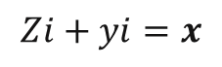
What do IO tables look like?
0.5 |  |  | 7 | 5
10 |  | 3
 |  | 1
 | 6 |  |  | 1
 |  | 2
5 | 4
2
5
12.5
13
10
9
7
Considering the economy as a closed system, consumption must be equal to production Total production (x) is equal to the total of intermediate consumption (Z) and final demand (y) We must add added value: wages, taxes and subsidies, profits, etc.
Z
y
x
The corresponding equation is Intermediate consumption + final demand = total output
1 | 3 | 2 | 2 | 0.5
1 | 4 | 2 |  | 0.5
VA
$$Zi+yi=x$$
Unit vector, allows the matrix to be summed in rows
12.5 | 13 | 10 | 9 | 7
= x
Σ

Slide 10
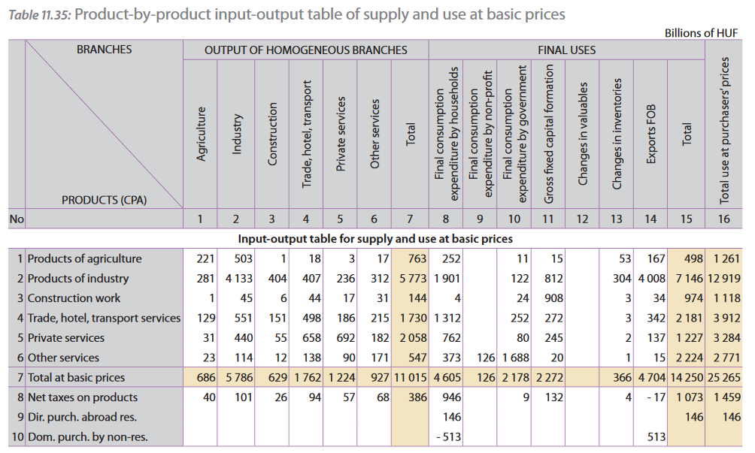
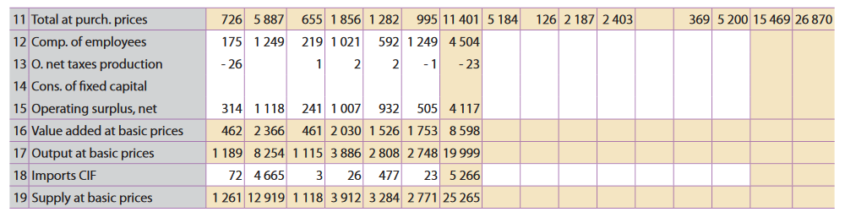
What do IO tables look like?
Hungarian IO table 1998 (in billions of forint) Including imports and exports, capital creation and consumption... … the equilibrium is found at 25265 billion forints
Z
y
x
VA
VA
x
https://digitallibrary.un.org/record/370160?ln=en

Slide 11
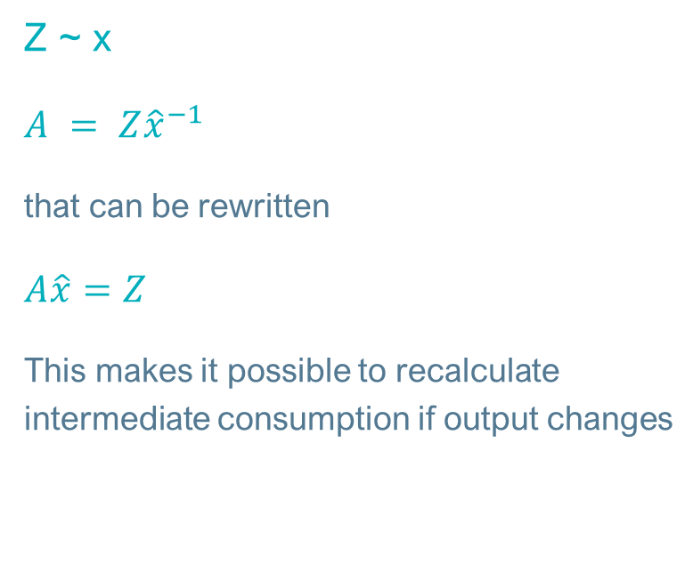
And so?
Z
y
x
Calculation of input coefficients
VA
Intermediate consumption (Z) is itself a function of total output (x), since inputs are proportional to what is produced If I need 2 eggs per cake, producing 2 cakes requires 4 eggs, so I have to calculate the coefficients per unit of production, so "divide" Z by x Matrix A gives me the “technical coefficients”
Z ~ x
$A = Z{\hat{x}}^{−1}$
that can be rewritten
$A\hat{x}=Z$
This makes it possible to recalculate intermediate consumption if output changes
0.5 |  |  | 7 | 5
10 |  | 3
 |  | 1
 | 6 |  |  | 1
 |  | 2
12.5
13
10
9
7
0.04 | 0.00 | 0.00 | 0.78 | 0.71
0.80 | 0.00 | 0.30 | 0.00 | 0.00
0.00 | 0.00 | 0.10 | 0.00 | 0.00
0.00 | 0.46 | 0.00 | 0.00 | 0.14
0.00 | 0.00 | 0.20 | 0.00 | 0.00
The mining sector needs 46 cents of manufactured goods per € of production

Slide 12
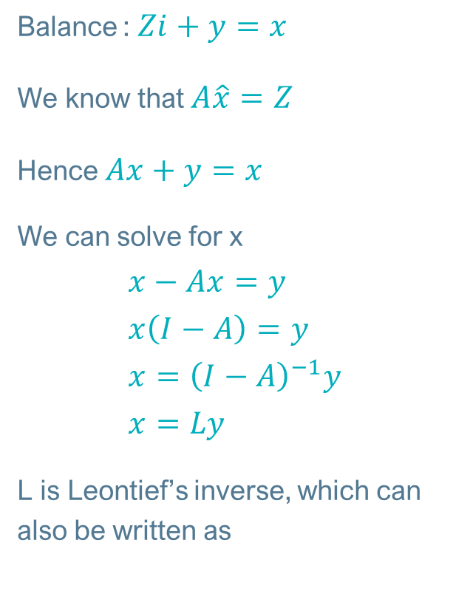
Leontief’s inverse
Z
y
x
Closing the IO system loop
VA
Balance : $Zi+y=x$
We know that $A\hat{x}=Z$
Hence $Ax+y=x$
We can solve for x $x−Ax=y$ $x\left(I−A\right)=y$ $x={\left(I−A\right)}^{−1}y$ $x=Ly$
L is Leontief’s inverse, which can also be written as
A
x
y
x
Intermediate consumption is proportional to total production, and we know that production = consumption Total output can therefore be directly deducted according to demand, i.e. the direct AND indirect consumption induced by a given demand
1.49 | 0.53 | 0.45 | 1.16 | 1.23
1.19 | 1.43 | 0.69 | 0.92 | 0.98
0.00 | 0.00 | 1.11 | 0.00 | 0.00
0.55 | 0.66 | 0.35 | 1.43 | 0.60
0.00 | 0.00 | 0.22 | 0.00 | 1.00
L
The entire mining value chain needs €0.66 of manufactured goods for €1 of output
$$L=I+A+A^{2}+A^{3}+…$$

Slide 13
Leontief’s inverse
Alternative interpretation
$$L=I+A+A^{2}+A^{3}+…$$
By definition, L contains the trade coefficients between sectors, covering direct trade and the entire upstream value chain, which can be reinterpreted
$$L=I+A+A^{2}+A^{3}+…$$
Final demand
(per unit of consumption, at least one unit of consumption must be produced)
Tier 1
(economic exchanges necessary to supply demand)
Tier 2
(economic exchanges necessary for the exchanges necessary to supply demand)
Tier 3
Etc. ☺

Slide 14
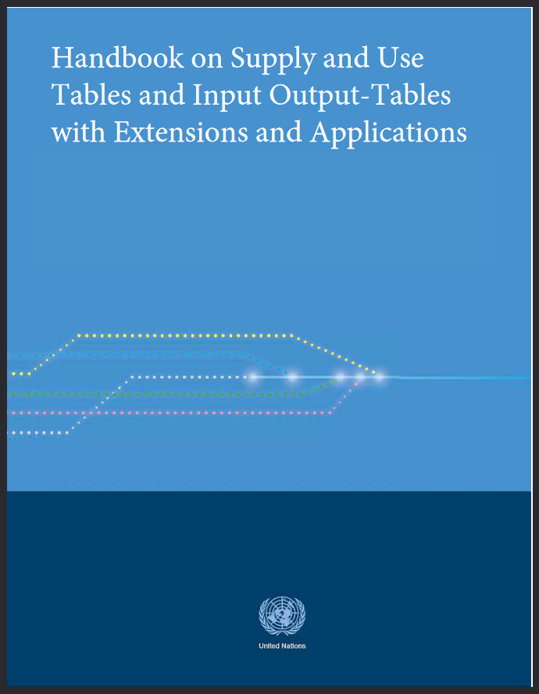
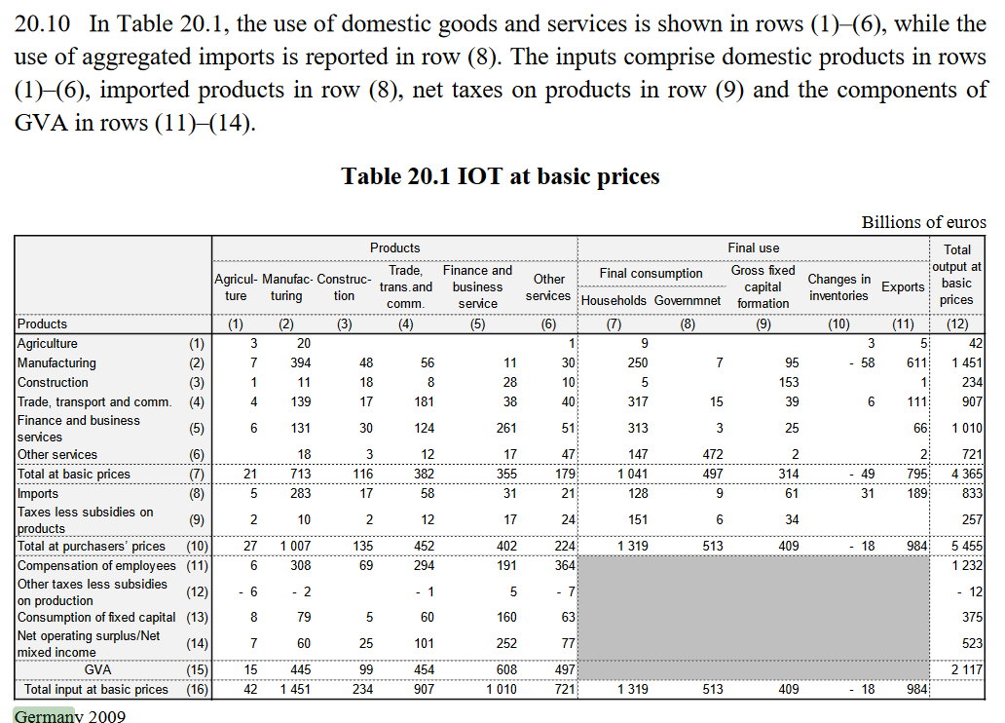
Exercice 1
Allemagne 2009
Compile
- Technical coefficients
- Leontief's matrix and inverse
Useful Excel formulas
MMULT(A,B)
MINVERSE(C)
Interprete ☺
https://unstats.un.org/unsd/nationalaccount/docs/SUT_IOT_HB_Final_Cover.pdf

Slide 15
02|Environmental extensions
Notebooks 1 et 2

Slide 16
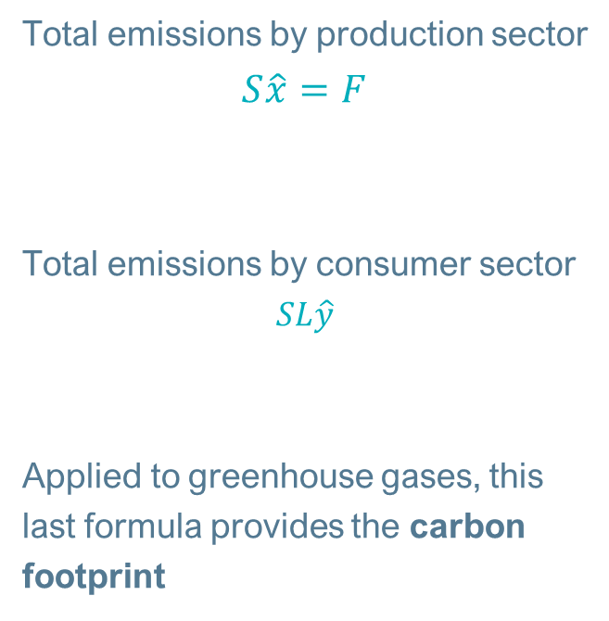
Environmental extensions
A "simple" extra matrix
A
y
x
Total emissions by production sector $S\hat{x}=F$
Total emissions by consumer sector $$SL\hat{y}$$
Applied to greenhouse gases, this last formula provides the carbon footprint
VA
CO2
CH4
N2O
S
It is possible to add a matrix containing the environmental information of each sector, e.g. greenhouse gas emissions

Slide 17
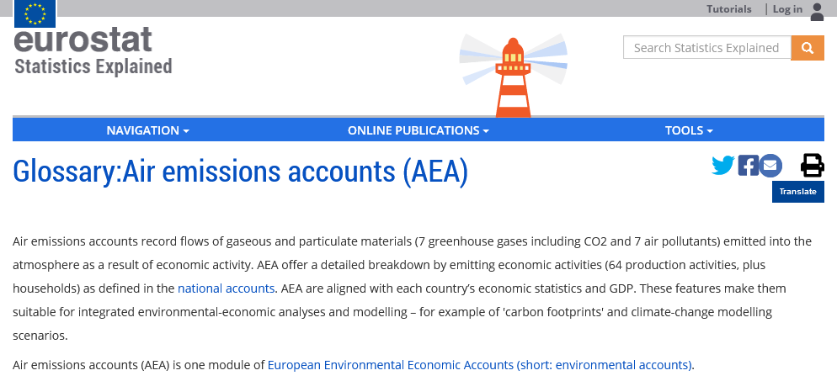
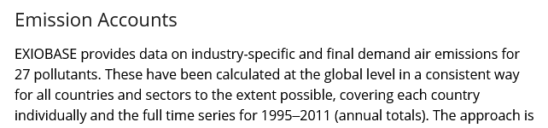
Environmental extensions
https://ec.europa.eu/eurostat/statistics-explained/index.php?title=Glossary:Air_emissions_accounts_(AEA)
A "simple" extra matrix
Air emissions, namely 7 greenhouse gases and 7 other pollutants, are an integral part of countries' national accounts.
These environmental accounts are an essential building block in carbon footprint calculations.
EXIOBASE uses other sources to complete this list, with 27 pollutants in total.
Stadler, K., Wood, R., Bulavskaya, T., Södersten, C. J., Simas, M., Schmidt, S., ... & Tukker, A. (2018). EXIOBASE 3: Developing a time series of detailed environmentally extended multi‐regional input‐output tables. Journal of Industrial Ecology, 22(3), 502-515.

Slide 18
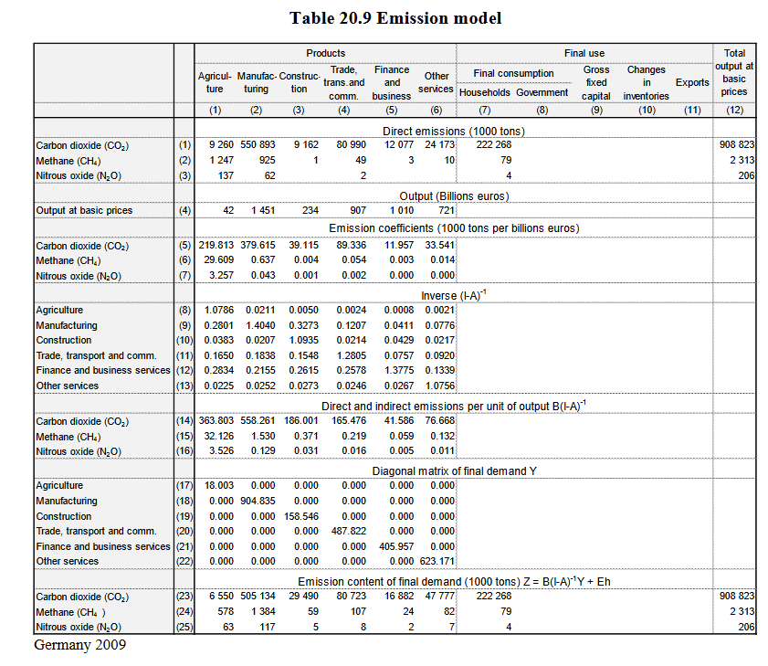
Exercise 2
Germany 2009
Compile
- Germany's total emissions by sector in 2009
- Direct emission factors per €
- Direct and indirect (life cycle) emission factors per €
- The carbon footprint of the final demand
Interprete ☺
?
?
?
?
?
https://unstats.un.org/unsd/nationalaccount/docs/SUT_IOT_HB_Final_Cover.pdf

Slide 19
03|Multiregional tables
Notebooks 1 et 2

Slide 20

The multiregional approach
Motivation
« The role of multiregional and multi-country analysis has grown in significance over the past two decades, with the use of multiregional SUT and IOT databases to inform worldwide policy research issues such as climate change, international trade, competitiveness and sustainable production and consumption policies. »
https://unstats.un.org/unsd/nationalaccount/docs/SUT_IOT_HB_Final_Cover.pdf

Slide 21
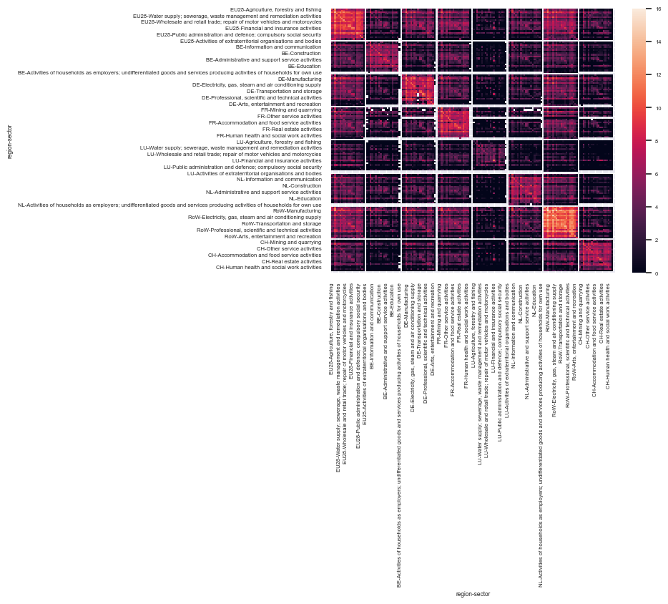
The multiregional approach
Tracking international value chains
EU28
BE
DE
FR
LU
NL
RoW
CH
The interest of working with a multi-regional table is manifold
Traceability of flows to and from other regions
Region-specific environmental factors
Final demand can be domestic or foreign
Compiling such a table requires much more effort in terms of data collection, quality checks, and handling it requires more computing resources
EU28
BE
DE
FR
LU
NL
RoW
CH

Slide 22
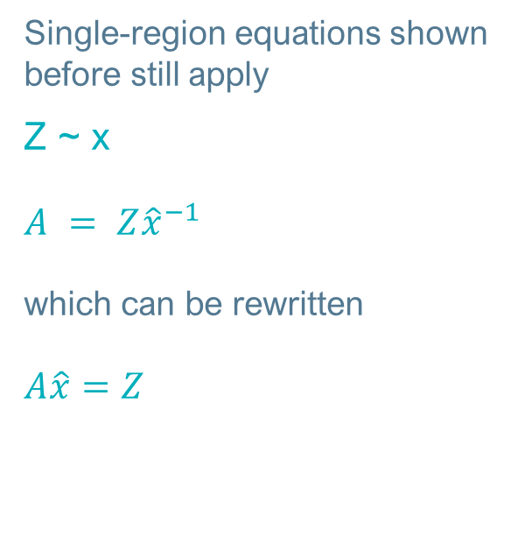
Environmentally-extended MRIO (EE-MRIO)
The multi-regional matrix
The compiled matrix, with its environmental extensions, can be further detailed by adding exchanges between different regions.
Single-region equations shown before still apply
Z ~ x
$A = Z{\hat{x}}^{−1}$
which can be rewritten
$A\hat{x}=Z$
A
y
x
trade
A
y
x
A
y
x
trade
A
y
x
VA
VA
VA
VA
A multi-regional matrix can be interpreted as a matrix in which imports and exports are disaggregated by country and sector of origin/destination
CO2
CH4
N2O
S
S
S
S

Slide 23
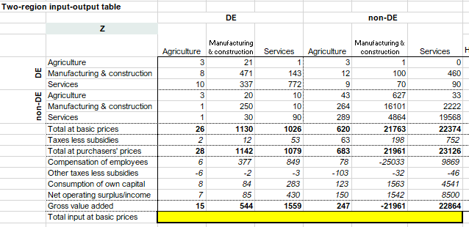
Exercice 3
Allemagne-reste du monde 2009
Compiler
- Les facteurs d’émission directs DE/non-DE par €
- Les facteurs d’émission directs et indirects DE/non-DE (cycle de vie) par €
- L’empreinte carbone de la demande finale de chaque région
Interpréter ☺
https://unstats.un.org/unsd/nationalaccount/docs/SUT_IOT_HB_Final_Cover.pdf

Slide 24
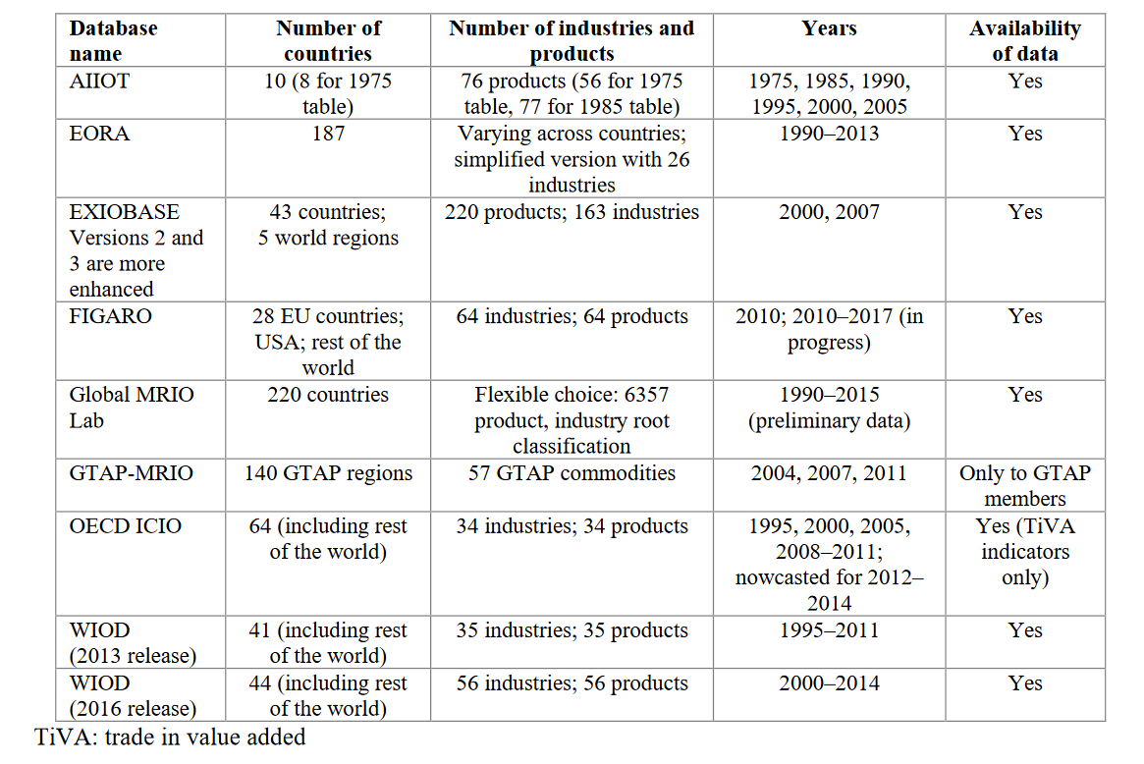
The multiregional approach
Databases
A multitude of databases exist, created with different objectives
Main ones are
Eora – non-free, the most detailed, with environmental extensions
EXIOBASE – free, EU28-centered
FIGARO – free (Eurostat), EU28-centered
GTAP – global initiative, geared towards economic applications
OECD ICIO – free, OECD-centered
WIOD – free, Europe-centered
1990-2022
44 countries
5 world regions
1995-2022
and 2014

Slide 25
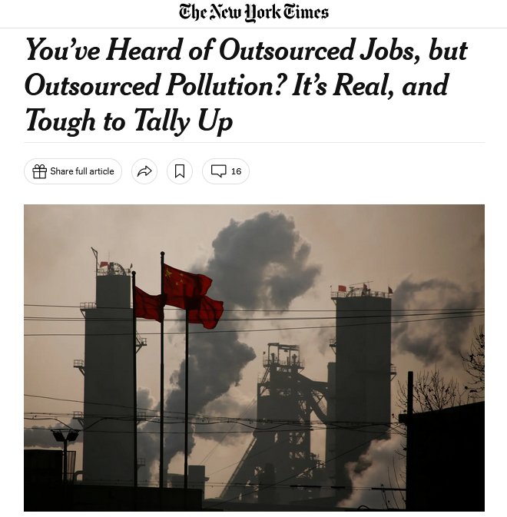
Eora
University of Sydney
A truly global MRIO database
15,909 sectors in 190 countries A complete time series for 1990-2022 2720 environmental indicators covering GHG emissions, employment, air pollution, energy use, water requirements, land use, N and P emissions, primary inputs from agriculture (including 172 crops) from FAOSTAT, and human ownership of net primary productivity
Two versions
a high-resolution version (“full Eora”) preserving the detail of the national input-output tables,
and a simplified version (“Eora26”) with a harmonised classification of 26 sectors
Applications
World Bank World Development Report 2020
The Carbon Loophole in Climate Policy Report - for the BuyClean initiative. (NY Times, NPR Marketplace)
UNCTAD World Investment Report 2018
IMF World Economic Outlook: 2016
Deloitte: Australia’s performance in the G20
Defra: UK official carbon footprint account
UNCTAD Global Value Chain database
EU DG Environment biodiversity footprint report
Climate Council of Australia, "Renewable Energy Jobs: Future Growth in Australia"
OECD African Economic Outlook
IMF Regional Economic Outlook: Sub-Saharan Africa
UNEP: Indicators for a Resource Efficient and Green Asia and the Pacific
Balancing the G20's Global Impact
Commonwealth Bank: Assessing the Carbon Emissions of the Group's Lending Portfolio
https://worldmrio.com/

Slide 26
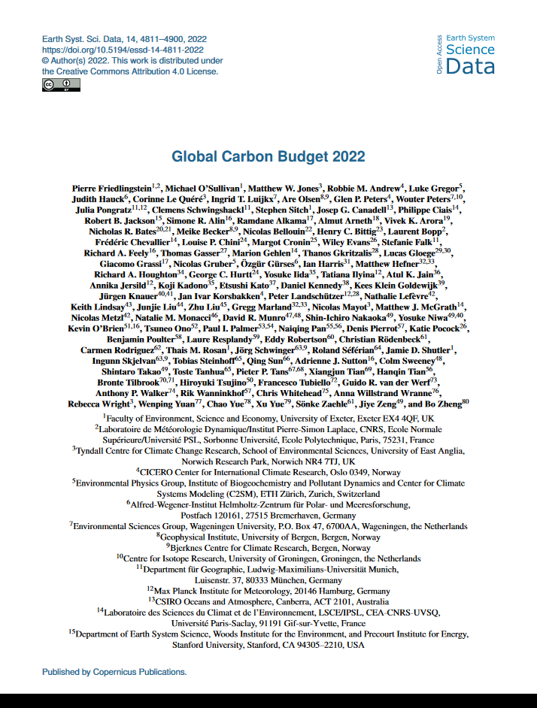
GTAP
Purdue University & international consortium
A global MRIO table
141 countries and regions 57 economic sectors Time series 1990–[year n-2] Environmental extensions
A recognized status
Maintained by a global network of researchers Table updated annually
Well-known applications
Global Carbon Budget
Global Footprint Network
(more on that later)
Friedlingstein, P., O'sullivan, M., Jones, M. W., Andrew, R. M., Gregor, L., Hauck, J., ... & Zheng, B. (2022). Global carbon budget 2022. Earth System Science Data Discussions, 2022, 1-159.

Slide 27

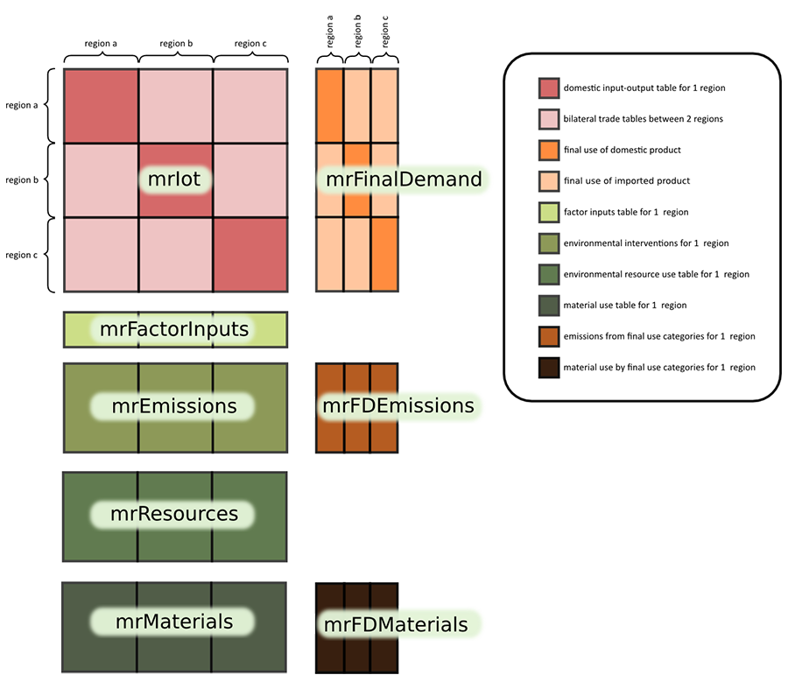
EXIOBASE (version 3.8.2)
Sources
NTNU (NO), CML
mrIot
economic table (44 pays + 5 regions) * 163 sectors
mrFactorInputs
9 value added categories 14 categories of employment statistics
mrEmissions
423 air emission categories
mrResources et mrMaterials
20 categories of land use 4 energy categories 440 resource categories (biotic and mineral) 194 categories of water footprint 9 categories of fossil resources
mrFinalDemand:
Households Non-profit organizations serving households (NPISH) Government Gross fixed capital formation Inventory Variance Change in value
mrFDEmissions et mrFDMaterials
Emissions and resources directly related to final demand
https://exiobase.eu/index.php/2-uncategorised/28-exiobase2-mr-iot
Notebook “1_introduction_structure_IO.ipynb”

Slide 28
Structure
io
Z
Y
satellite
D_pba
D_pba_reg
D_pba_cap
D_cba
D_cba_reg
D_cba_cap
impacts
F
S
F
S
D_pba
D_pba_reg
D_pba_cap
D_cba
D_cba_reg
D_cba_cap
F_Y
F_Y
D_imp
D_exp
D_imp_reg
D_imp_cap
D_exp_reg
D_exp_cap
D_imp
D_imp_reg
D_imp_cap
D_exp
D_exp_reg
D_exp_cap
M
M
A
X
L
Z, Y, F, and F_Y are the only input data
Everything else is calculated
Economic flows
x: total output
A: technical coefficients
L: Leontief inverse
Environmental extensions
S: direct emission factors
M: life cycle emission factors
Rapports environnementaux
D_[imp/exp/pba/cba]: import/export/production/consumption emissions
D_*_[reg/cap]: same thing, aggregated by region or per capita
Notebook “1_introduction_structure_IO.ipynb”

Slide 29
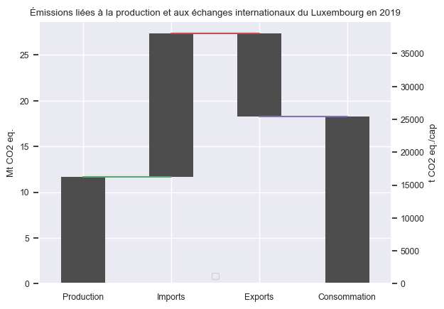
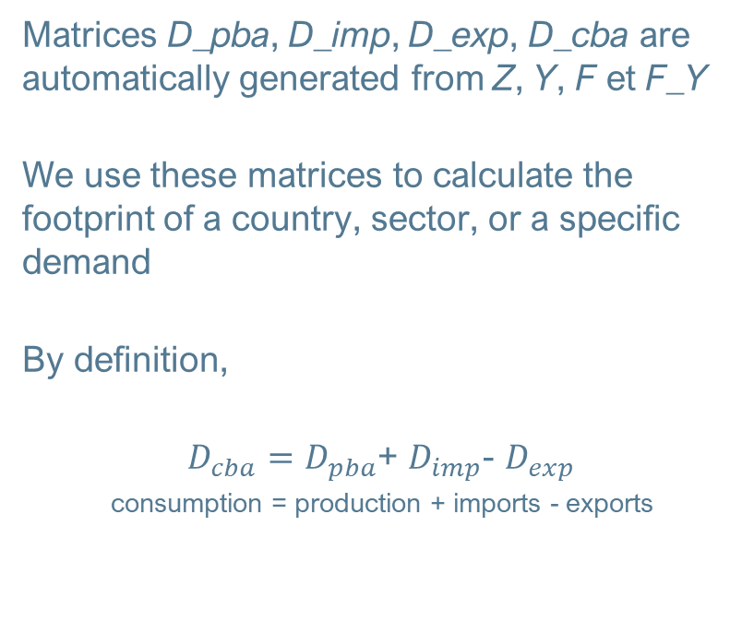
EXIOBASE (version 3.8.2)
Application 1: footprint calculation
Matrices D_pba, D_imp, D_exp, D_cba are automatically generated from Z, Y, F et F_Y
We use these matrices to calculate the footprint of a country, sector, or a specific demand
By definition,
$D_{cba}=D_{pba}$+ $D_{imp}$- $D_{exp}$
consumption = production + imports - exports
Source: EXIOBASE 3.8.2
Notebook “2_empreinte_Luxembourg.ipynb”

Slide 30
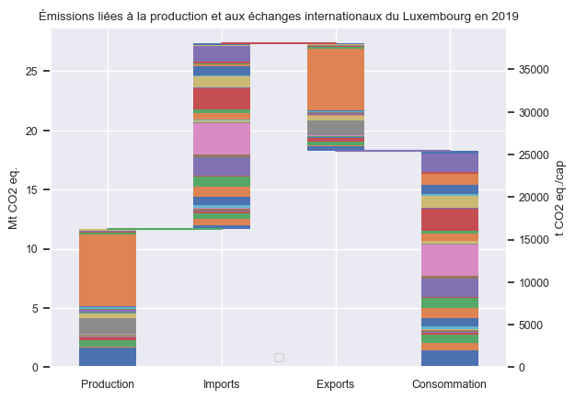

EXIOBASE (version 3.8.2)
Application 1: footprint calculation
Disaggregation by sector, Luxembourg
In your opinion, where do most emissions come from? (> 1 Mt/year)
Aviation: 5.4 Mt CO₂ eq.
Chemicals: 2.3 Mt CO₂ eq.
Petroleum refining: 1.5 Mt CO₂ eq.
Automotive production: 1.3 Mt CO₂ eq.
Direct emissions: 1.2 Mt CO₂ eq.
Health and social: 1.1 Mt CO₂ eq.
Source: EXIOBASE 3.8.2
Notebook “2_empreinte_Luxembourg.ipynb”

Slide 31
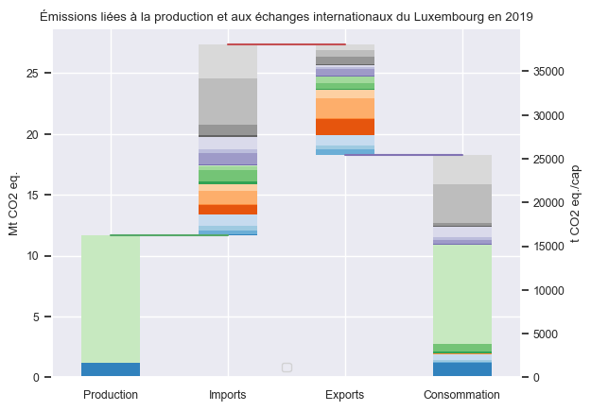
EXIOBASE (version 3.8.2)
Application 1: footprint calculation
Disaggregation by country, Luxembourg
In your opinion, where do most emissions come from? (> 1 Mt/year)
Asia: 2.4 Mt CO₂ eq. imp
Middle East: 1.8 Mt CO₂ eq. imp
France : 1.4 Mt CO₂ eq.
Germany : 1.2 Mt CO₂ eq.
Africa: 1.2 Mt CO₂ eq.
Source: EXIOBASE 3.8.2
Notebook “2_empreinte_Luxembourg.ipynb”

Slide 32
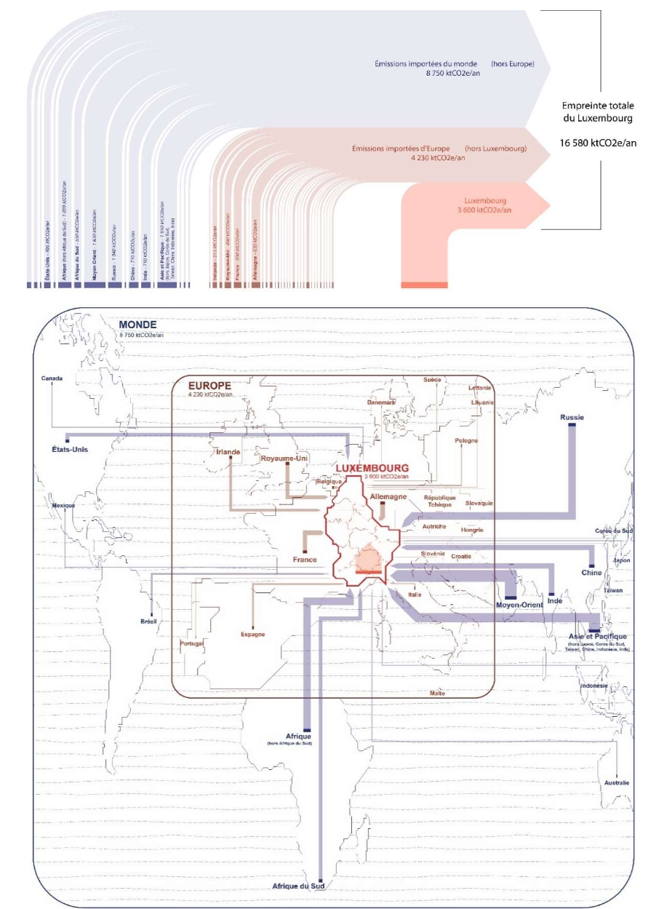
EXIOBASE (version 3.8.2)
Application 1: footprint calculation
World (mainly oil and oil products – Middle-East, Russia, but also finished products – China, USA, South Africa…)
Europe Germany, France, UK
Luxembourg Domestic production
Source: EXIOBASE https://luxembourgintransition.lu/wp-content/uploads/2021/02/Luxembourg-en-Transition_Equipe-AREP-flux-Livrable-Phase-1_20210104-_-RAPPORT-avec-annexes.pdf
Notes:
Une autre representation qui montre d’où provient notre carbone importé, et via quels produits. Cette illustration a été extraite du rapport d’une autre équipe, avec de meilleurs talents graphiques.

Slide 33
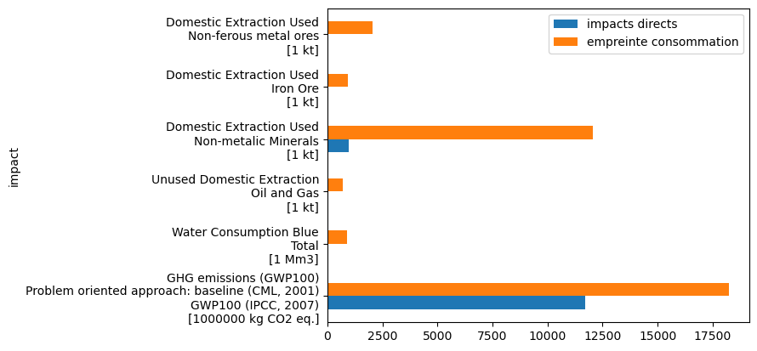
EXIOBASE (version 3.8.2)
Application 1: footprint calculation
The same calculations are reproducible for any indicator
Notebook “2_empreinte_Luxembourg.ipynb”

Slide 34
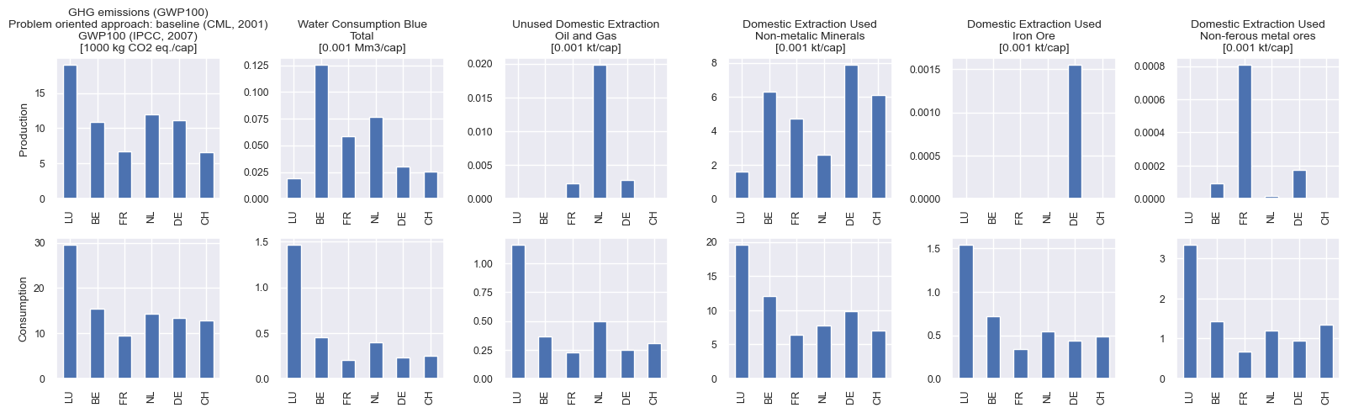
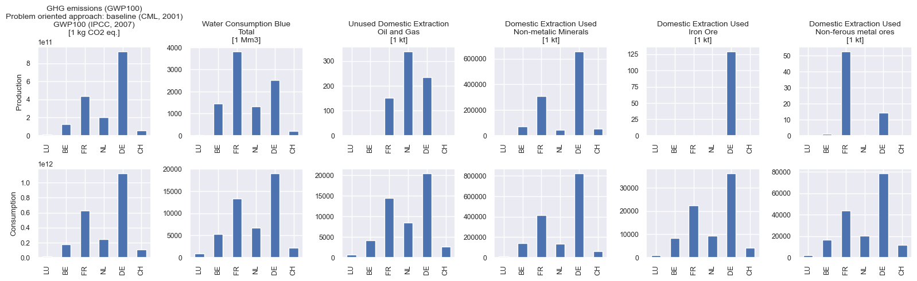
EXIOBASE (version 3.8.2)
Application 1: footprint calculation
Notebook “2_empreinte_Luxembourg.ipynb”

Slide 35
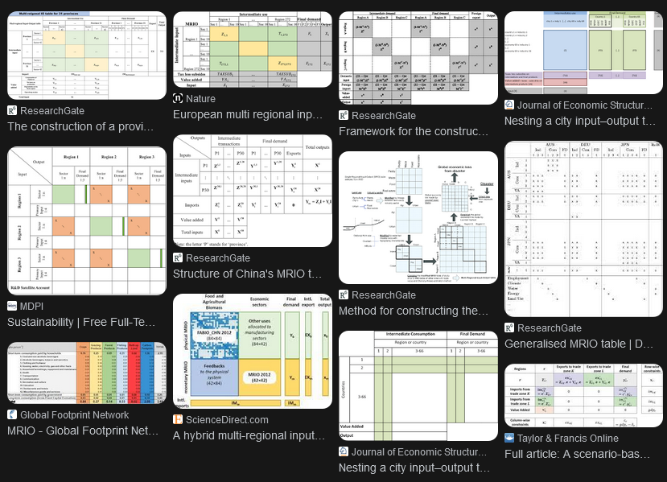
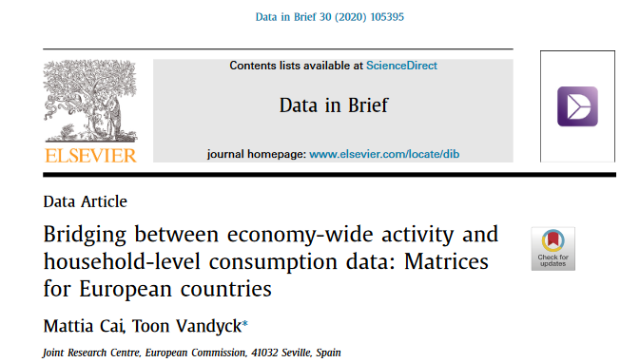
EXIOBASE (version 3.8.2)
Googling “MRIO aggregation”
Application 2: aggregation
Regional or sectoral aggregation is often necessary, either to calculate results more quickly or to present more readable results
It is inevitable when it comes to aligning incompatible classifications, the typical example is the calculation of the carbon footprint of households
The budget surveys are in the "COICOP" (consumer goods) format, used by customs/the UN, while the tables are in the "CPA" (or NACE) format, which is more convenient for economists/statisticians to handle
Notebook “3_agrégation.ipynb”

Slide 36
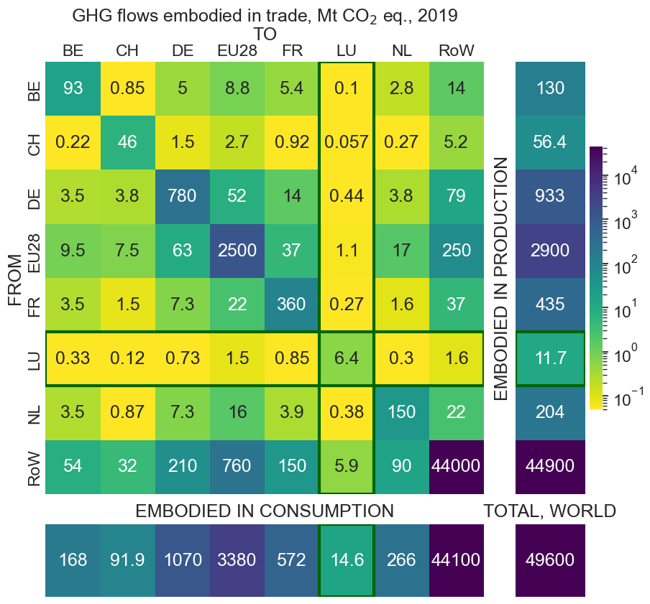
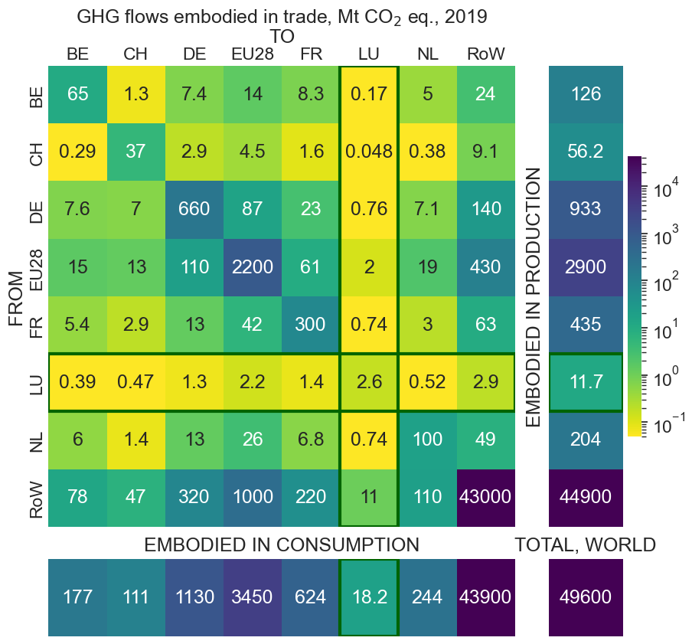
EXIOBASE (version 3.8.2)
Application 2: regional and sectoral aggregation
Agrégation économique puis calcul d’empreinte
Calcul d’empreinte puis agrégation
Pourquoi une telle différence ?
Notebook “3_agrégation.ipynb”

Slide 37
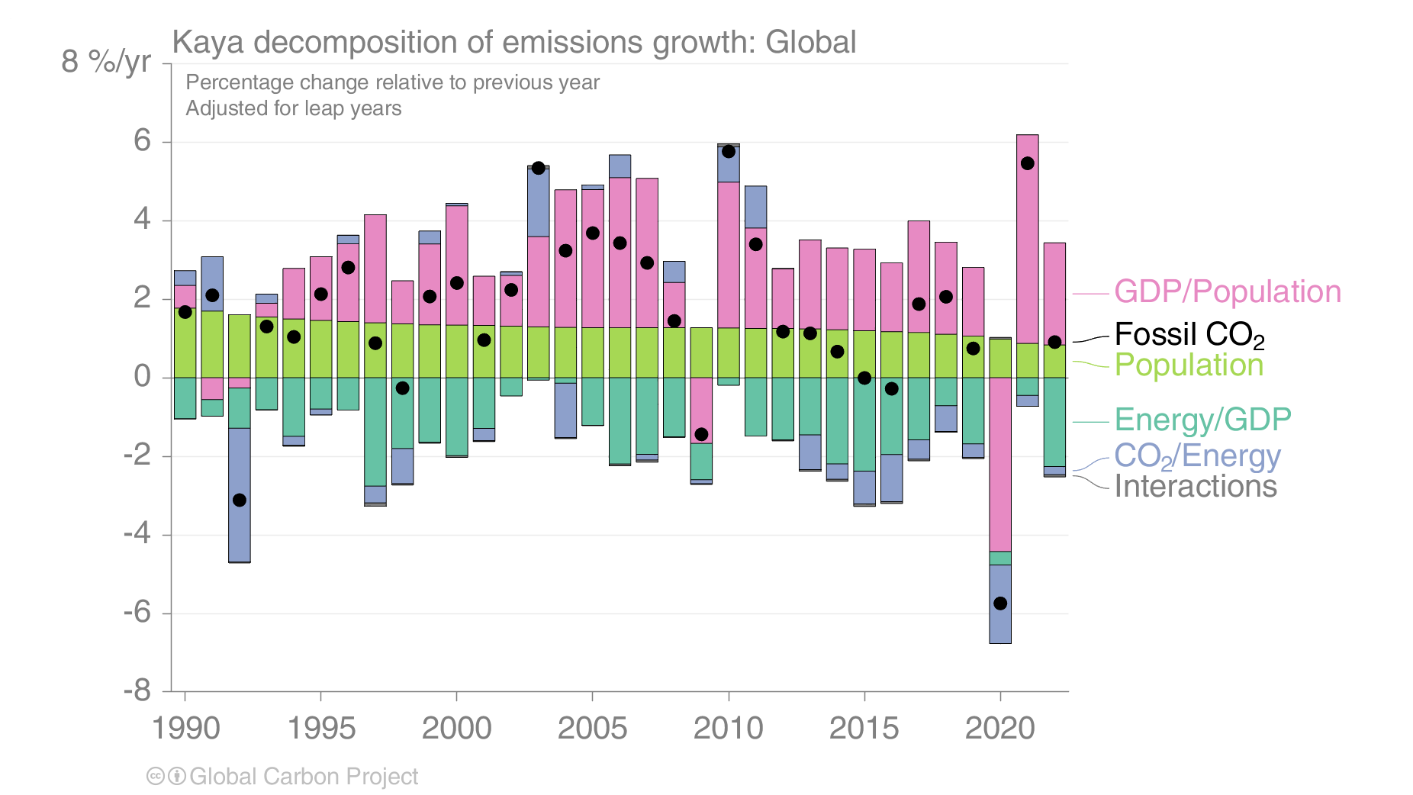

EXIOBASE (version 3.8.2)
Application 3: décomposition
Il est possible de décomposer l’évolution temporelle de l’empreinte carbone en différents facteurs
La décomposition la plus connue repose sur l’identité de Kaya
$$CO2= \frac{CO2}{Energy}\frac{Energy}{GDP}\frac{GDP}{Population}Population$$
https://robbieandrew.github.io/GCB2023/PNG/s27_2023_Kaya_World.png
Notebook “4_décomposition.ipynb” in progress
Notes:
On a global level, there appears to be sparse evidence for absolute decoupling between economic growth, metal consumption, and the embodied impacts of the latter. The decomposition results of this paper clearly align with previous findings on increasing affluency being the main driver of environmental impacts. (6,17,25) Population growth is an important driver of the emissions but also a driver that few governments try to influence directly. Historically, urbanization and increasing affluency in a region have been the most effective way of reducing population growth. (57) However, there is an immediate cost in terms of resource use, as increasing affluency in turn drives up metal consumption to a higher per capita level. An interesting finding is that global population composition is a negative driver (Figure 2a). It means that the share of the global population living in regions whose carbon footprint of metal use is lower than average is increasing.

Slide 38
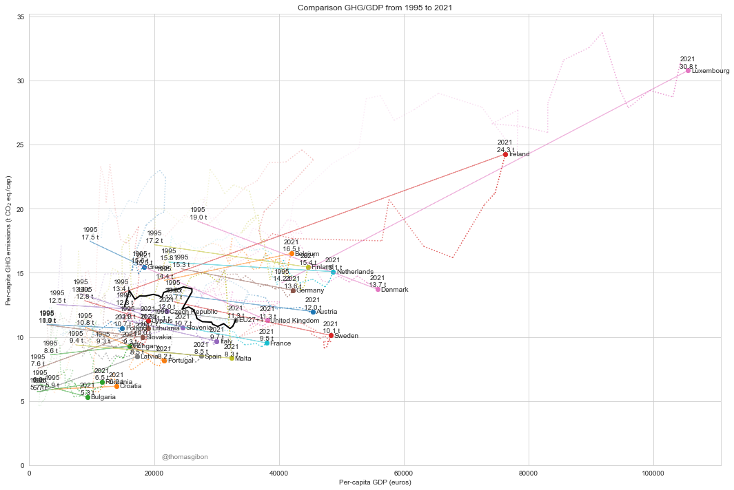
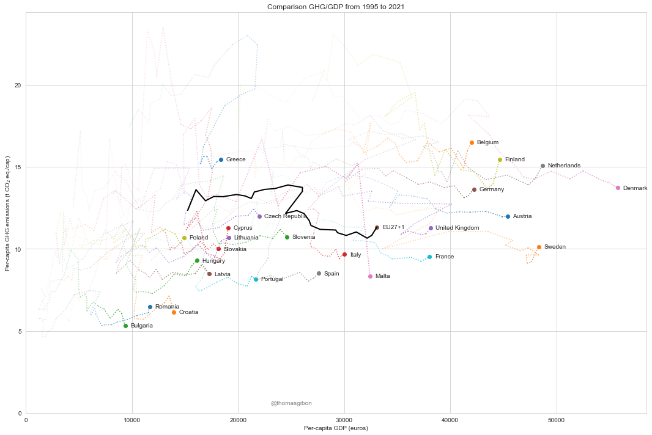
EXIOBASE (version 3.8.2)
Application 4: analyse du découplage
On peut utiliser les séries temporelles d’EXIOBASE pour faire une analyse du découplage entre le PIB et l’empreinte GES de chaque pays
N’oublions pas qu’EXIOBASE est d’abord une table économique! et permet de calculer facilement le PIB de chaque pays et secteur
Les limites d’EXIOBASE pour le Luxembourg (comptabilité statistique n’excluant pas la consommation des non-résidents) est clairement visible ici
Notebook “5_découplage.ipynb”

Slide 39
EXIOBASE (version 3.8.2)
Application 4: analyse du découplage
On peut utiliser les séries temporelles d’EXIOBASE pour faire une analyse du découplage entre le PIB et l’empreinte GES de chaque pays
N’oublions pas qu’EXIOBASE est d’abord une table économique! et permet de calculer facilement le PIB de chaque pays et secteur
Les limites d’EXIOBASE pour le Luxembourg (comptabilité statistique n’excluant pas la consommation des non-résidents) est clairement visible ici
Notebook “5_découplage.ipynb”

Slide 40
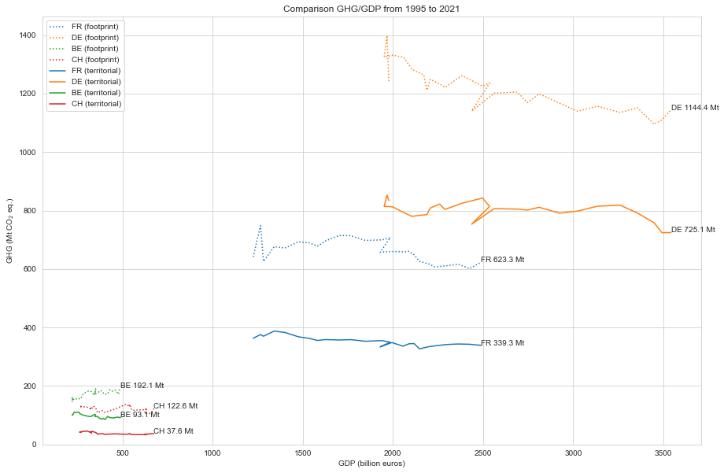
EXIOBASE (version 3.8.2)
Application 4: analyse du découplage
Même chose ici avec la comparaison empreinte territoriale/empreinte
Pour Allemagne, France, Belgique, Suisse
(Luxembourg à ajouter)

Slide 41
04|Examples of applications

Slide 42
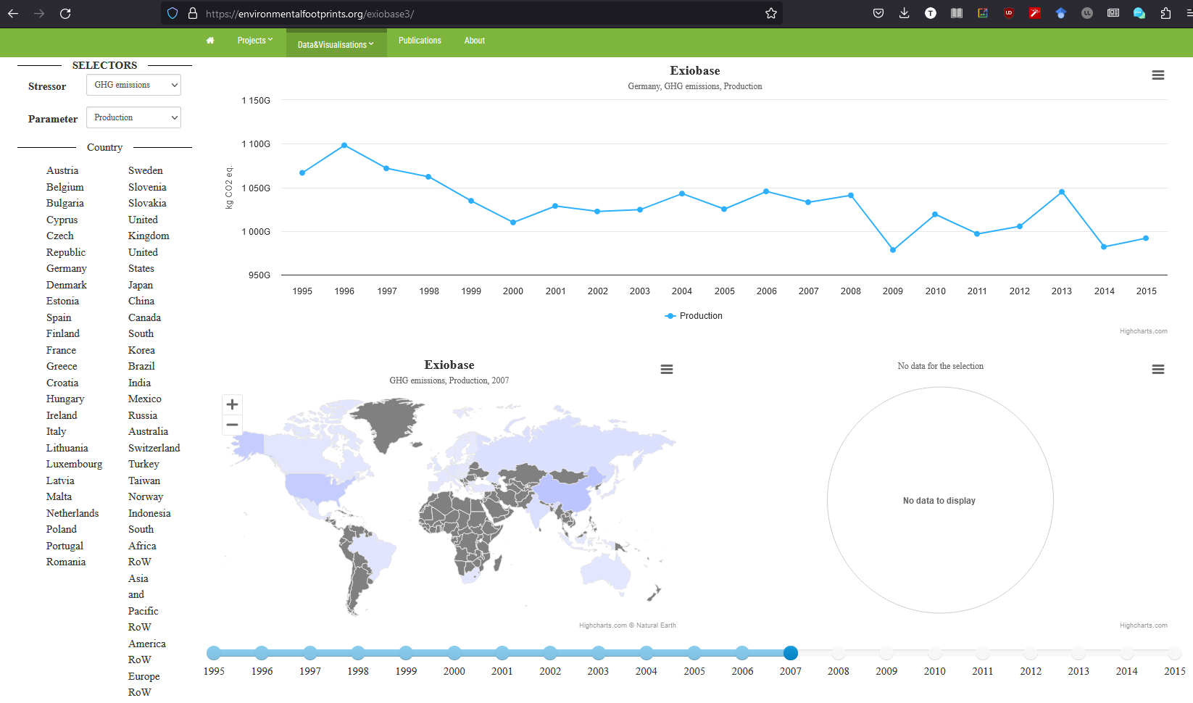
Aggregated EXIOBASE results
NTNU
The aggregated results by environmental impacts and by country are directly available at https://environmentalfootprints.org
5 types of impacts are available (GHGs, energy, materials, water (blue) and land footprint) for production, consumption, net trade (import-export), consumption per capita, and production and consumption per unit of GDP
Warning: the time series ends in 2015

Slide 43
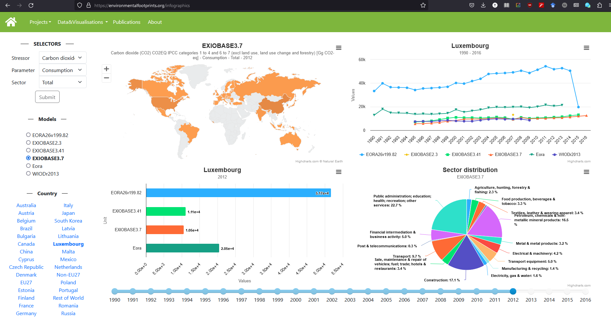
Comparison between databases
NTNU
Comparison between Eora, EXIOBASE (2.3, 3.41, 3.7) and WIOD
For some thirty indicators, 7 perspectives (production, cons...), and 17 sectors Available at https://environmentalfootprints.org/infographics

Slide 44
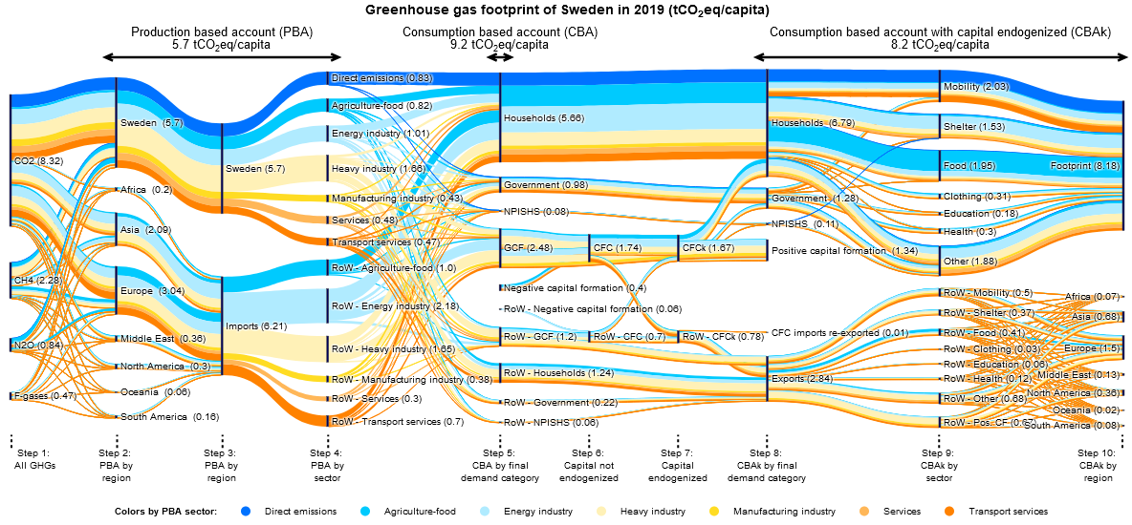
Tracking greenhouse gas flows
https://sankey.theshiftproject.org/
The Shift Project

Slide 45
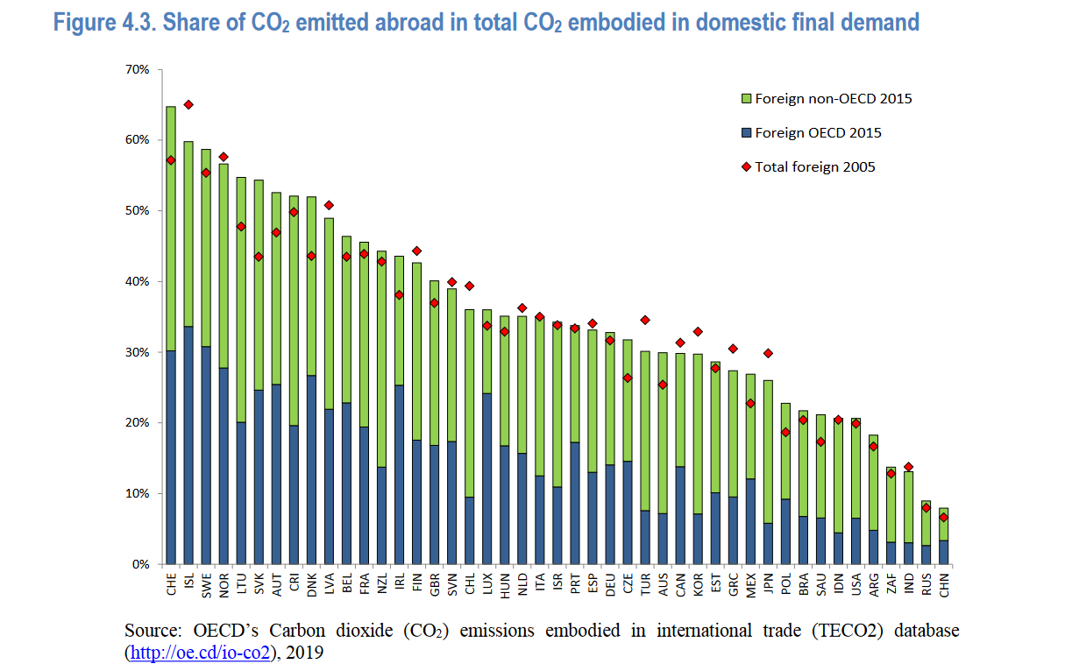
CO2 emissions from international trade
OECD (2020)
CO₂ embodied in total exports and imports, from domestic and foreign sources, for the main countries and regions13 participating in international trade.
In terms of individual countries, in 2015 the United States was the largest net importer of CO₂, 0.79 Gt, and China the largest net exporter, 1.3 Gt.
Reflecting the previous analysis of consumption-based emissions, the majority of selected OECD and EU 28 countries are net importers of emissions while the non-OECD and ASEAN countries are net exporters.
https://www-oecd-ilibrary-org.proxy.bnl.lu/science-and-technology/co2-emissions-embodied-in-international-trade-and-domestic-final-demand_8f2963b8-en

Slide 46
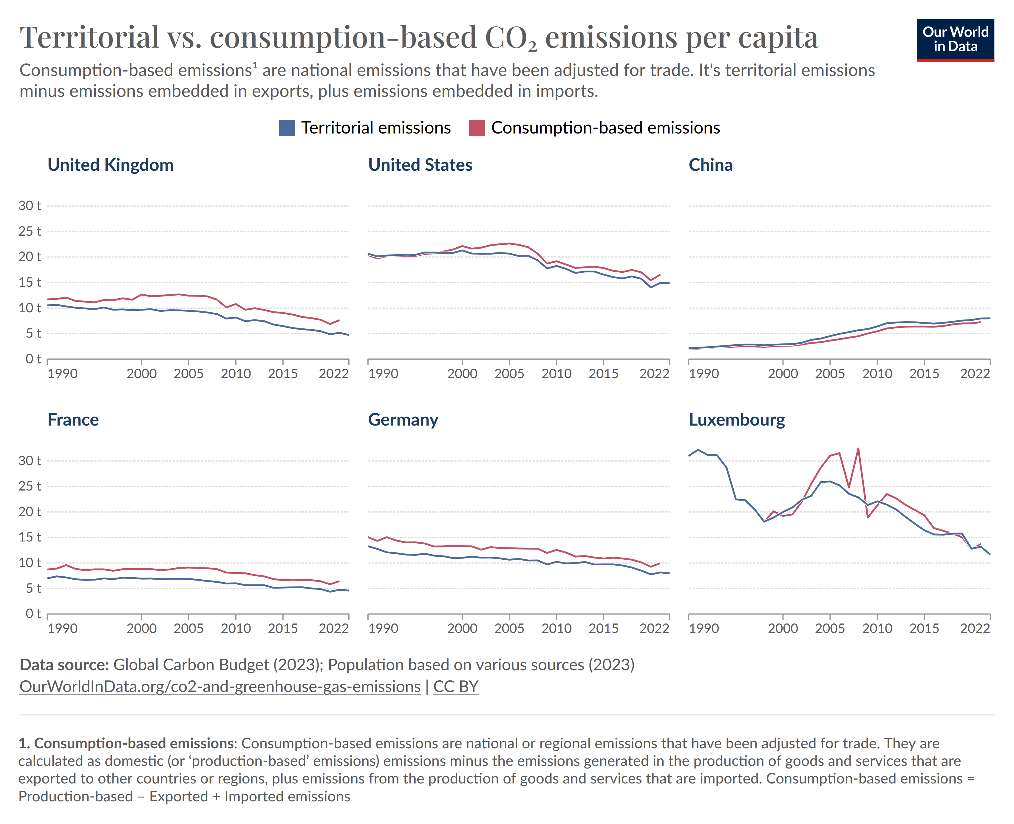
Territorial vs. consumption-based CO2 emissions per capita
OurWorldInData
https://ourworldindata.org/grapher/prod-cons-co2-per-capita
Global Carbon Budget data, which uses the GTAP table
Only takes into account CO2 emissions (the only greenhouse gas)
Pros
Very good regional detail Annual update
Easy to navigate and operate via a very good integration with OurWorldInData

Slide 47
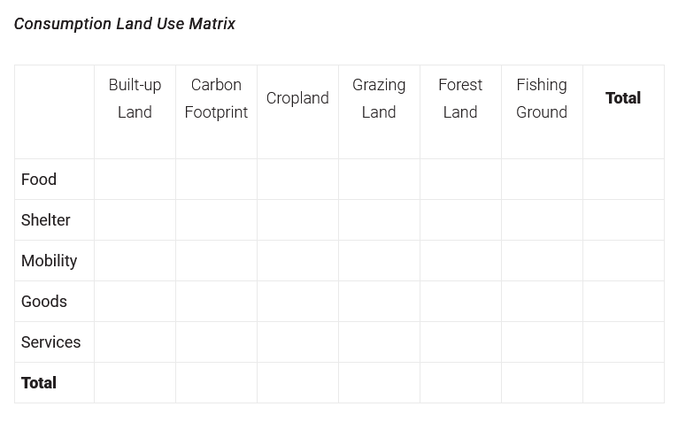
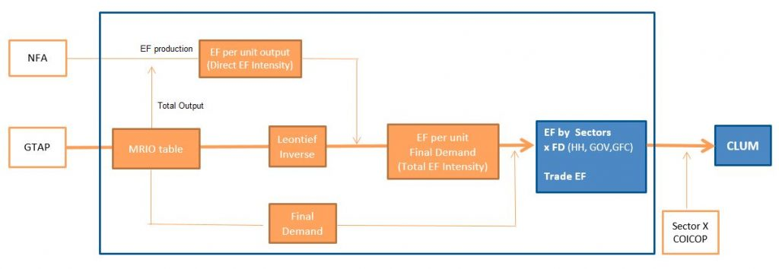
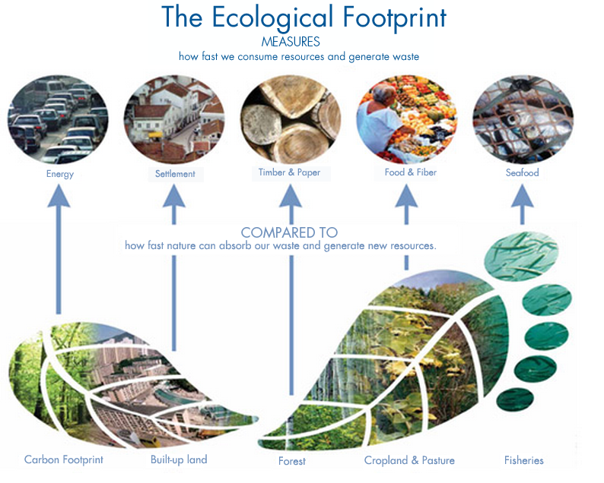
Ecological footprint
Global Footprint Network
The GFN uses an adapted version of the GTAP database (version 10), whose "CLUM" (Consumption Land Use Matrix) result allocates the six components of the ecological footprint to household consumption categories
The structure of Ecological Footprint MRIO analysis

Slide 48
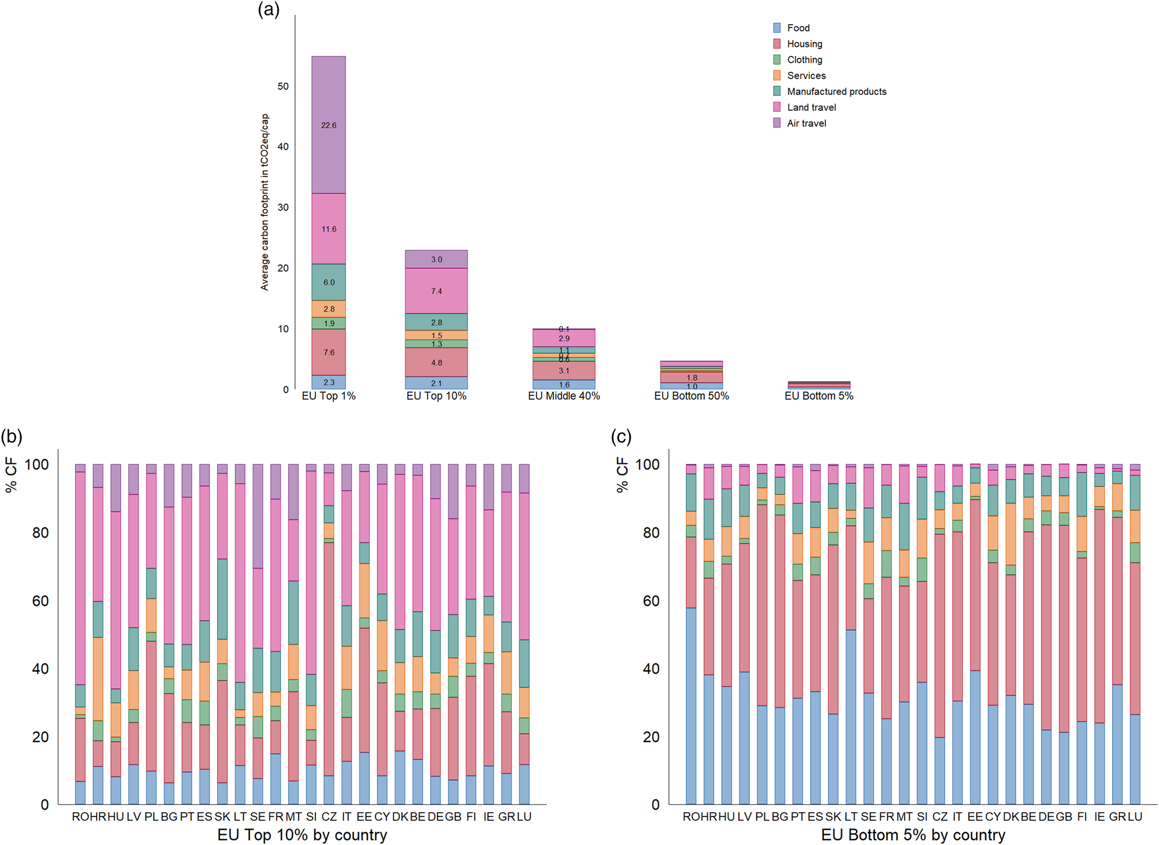
Analysing carbon inequalities
Ivanova & Wood 2020
Average carbon footprint (CF) distribution by consumption category in the European Union (EU) (top)
The bottom graph depicts the average CF shares by consumption category and countries of EU top 10% emitters on the left (with CF >15 tCO₂eq/cap) and EU bottom 5% of emitters on the right (with CF <2.5 tCO₂eq/cap).
Ivanova, D., & Wood, R. (2020). The unequal distribution of household carbon footprints in Europe and its link to sustainability. Global Sustainability, 3, e18.

Slide 49
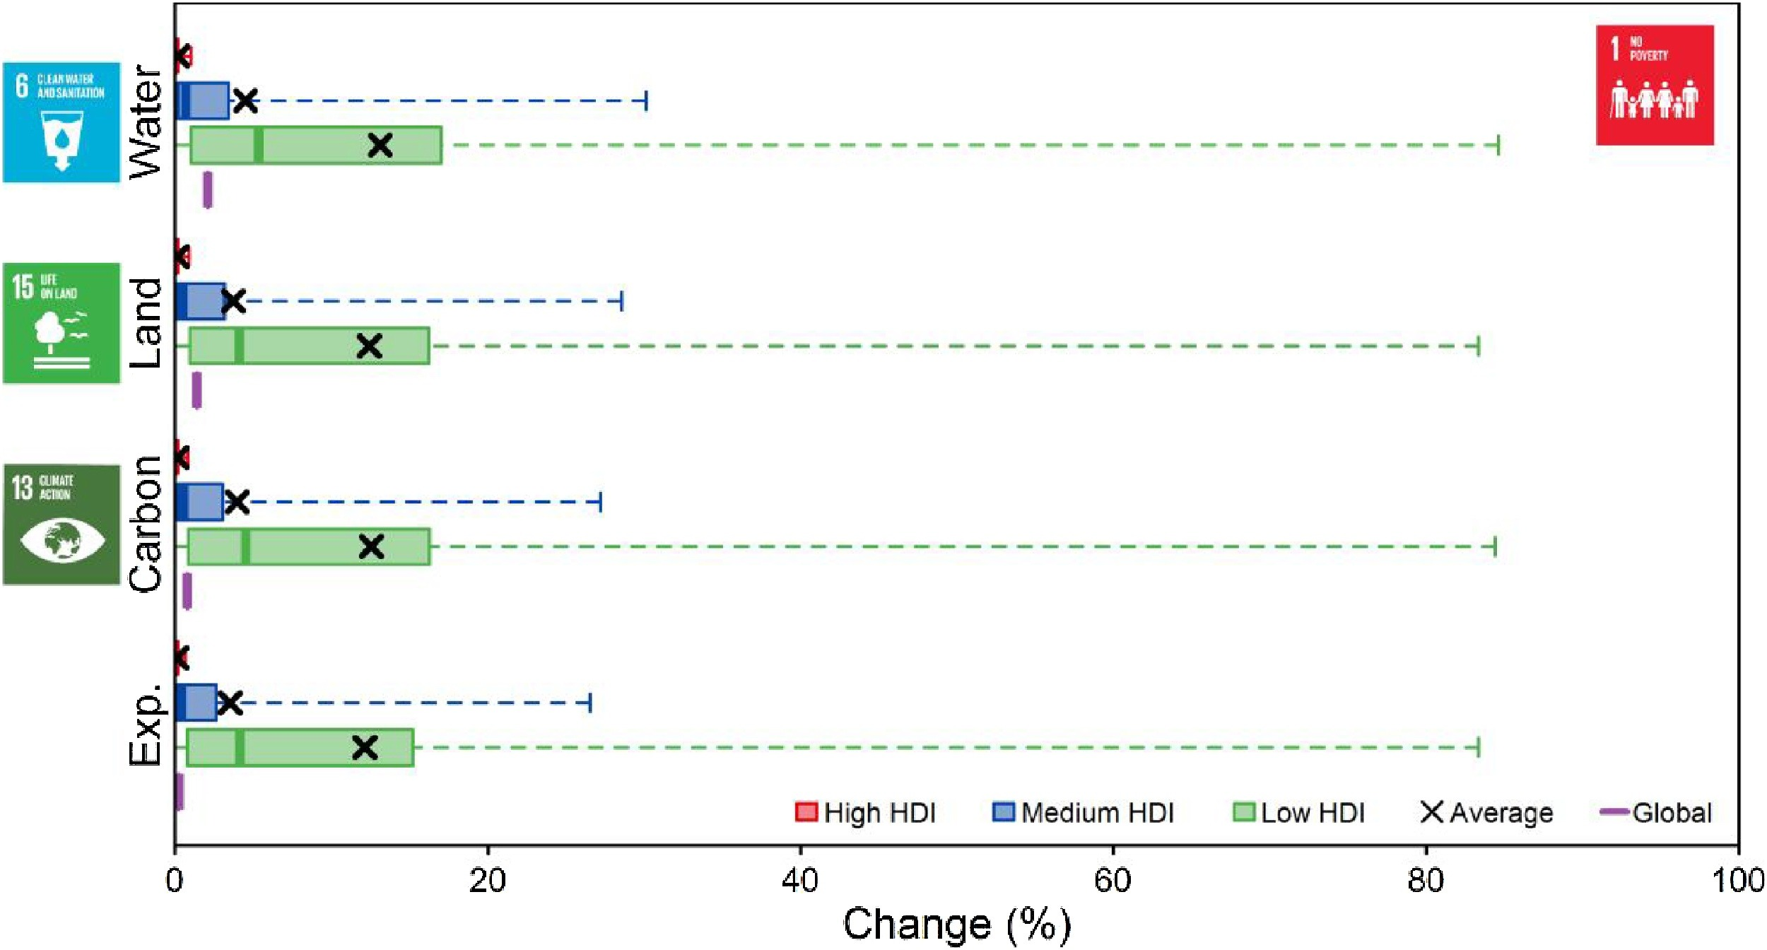
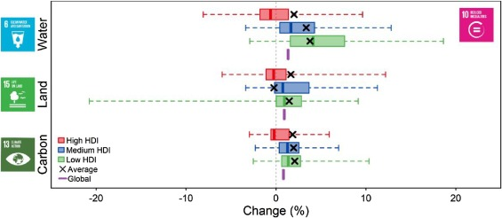
Le coût environnemental de la lutte contre les inégalités
Scherer et al. 2018
Environmental impacts of meeting a minimum income of $1.25 a day (SDG 1). Countries are grouped by the human development index (HDI, low: <0.55, medium: 0.55–0.7, high: >0.7).
Environmental impacts of reducing inequality (SDG 10, here: limiting the income Gini index to a maximum of 0.3). Countries are grouped by the human development index (HDI).
Scherer, L., Behrens, P., de Koning, A., Heijungs, R., Sprecher, B., & Tukker, A. (2018). Trade-offs between social and environmental Sustainable Development Goals. Environmental science & policy, 90, 65-72.

Slide 50
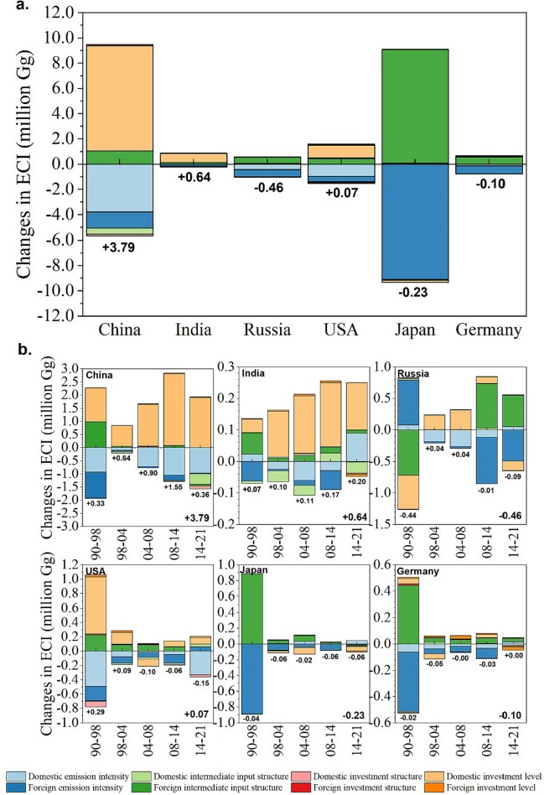
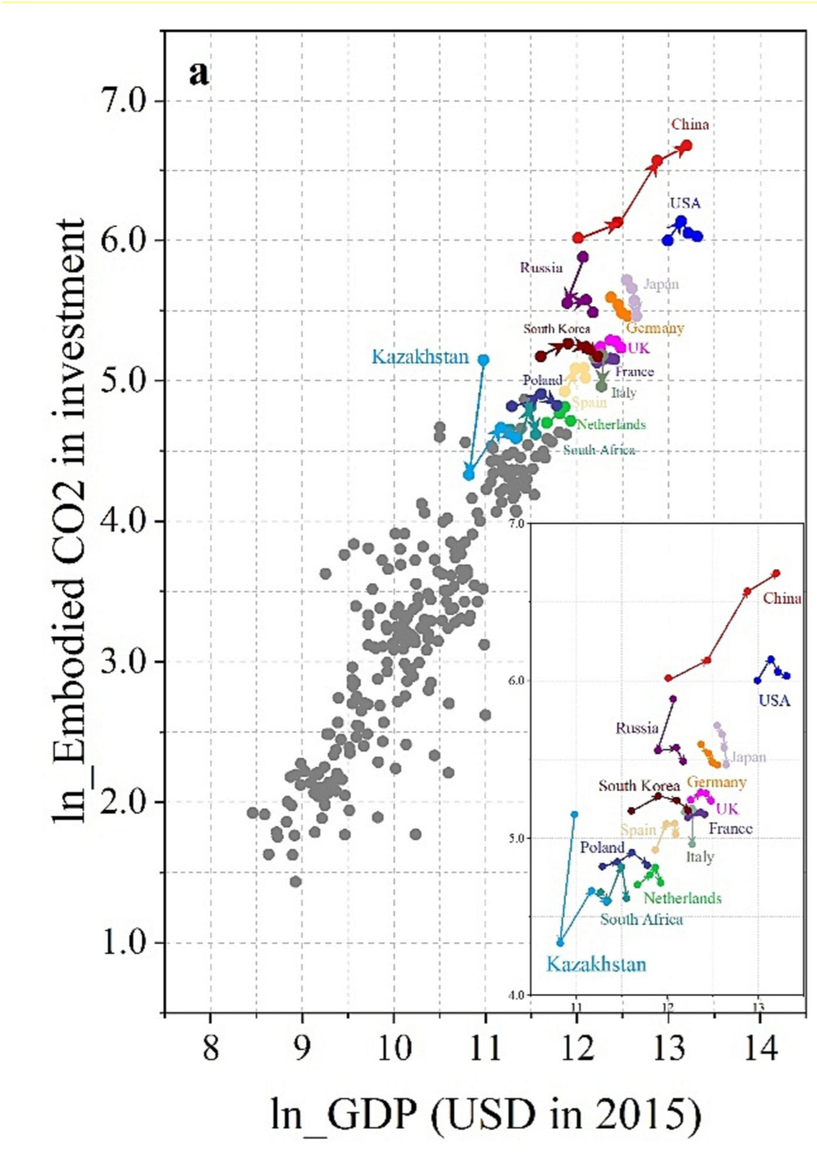
CO₂ “verrouillé” par les investissements
Liang et al. 2024
Structural decomposition analysis results for the ECI in six countries, 1990–1998–2004-2008-2014-2021
(a) illustrates the effects of eight driving factors in the ECI in six countries from 1990 to 2021.
Each subgraph in (b) shows the effects of the eight factors during five sub-periods.
Liang, J., Wang, S., Liao, Y., & Feng, K. (2024). Carbon emissions embodied in investment: Assessing emissions reduction responsibility through multi-regional input-output analysis. Applied Energy, 358, 122558.

Slide 51

Carbon footprint of "green" funds
Fonds conventionnels
Fonds verts
Popescu et al. 2023
It is possible to link EXIOBASE to a database of investment funds, in particular with information on geographical distribution and sectors of activity
When comparing SRI ("green") funds and conventional funds, it is difficult to identify a significant difference in terms of environmental impacts
The weight of Scope 3 (upstream issuance) is such that SRI funds are not significantly less emitting than traditional funds
Impacts d’un investissement
Fonds conventionnels
Fonds verts
Impacts du revenu total des entreprises du fond
Popescu, I. S., Gibon, T., Hitaj, C., Rubin, M., & Benetto, E. (2023). Are SRI funds financing carbon emissions? An input-output life cycle assessment of investment funds. Ecological Economics, 212, 107918.
Notes:
Popescu, I. S., Gibon, T., Hitaj, C., Rubin, M., & Benetto, E. (2023). Are SRI funds financing carbon emissions? An input-output life cycle assessment of investment funds. Ecological Economics, 212, 107918.

Slide 52

Plastics Value Chain Analysis
Cabernard et al. 2022
a–e, The sum of each horizontal bar of the flow chart refers to the carbon footprint of global plastics production in 2015 (1.9 Gt CO2 eq., 100%) and allocates it to the different perspectives in the global value chain: the sectors where GHG emissions are released
The small graphs on the right show the temporal evolution of the carbon footprint of global plastics production for each perspective
a
Cabernard, L., Pfister, S., Oberschelp, C., & Hellweg, S. (2022). Growing environmental footprint of plastics driven by coal combustion. Nature Sustainability, 5(2), 139-148.

Slide 53


Biodiversity footprint
Global biodiversity score
EXIOBASE is coupled with the "GLOBIO" database, which makes it possible to calculate the impacts of consumption on biodiversity in a detailed way
EXIOBASE is "poorly equipped" for the biodiversity dimension, this work (by CDC Biodiversité) makes it possible to fill this gap
https://www.cdc-biodiversite.fr/documentation-gbs/
Notes:
https://www.cdc-biodiversite.fr/documentation-gbs/

Slide 54


Projections (energy)
Luu et al. (2023)
Integration of energy scenarios in the Italian national table and analysis of the prospective impacts
Strong hypothesis: the rest of the economy is static!
Correcting this aspect requires micro-/macro- economics models
Luu, L. Q., Gibon, T., Cellura, M., Sanseverino, E. R., & Longo, S. (2023). Integrated hybrid multi-regional input-output for assessing life cycle air emissions of the Italian power system. Energy, 130109.

Slide 55



Projections (final consumption)
Bjelle et al. (2021)
From elasticity calculations, it is possible to model future demand due to a change in incomes
Strong assumption: Leontief's inverse is considered static (2011) for all prospective scenarios
Élasticité prix-revenus
Comparaison de la répartitions des impacts prospective/statique
Bjelle, E.L., Wiebe, K.S., T¨obben, J., Tisserant, A., Ivanova, D., Vita, G., Wood, R., 2021. Future changes in consumption: the income effect on greenhouse gas emissions. Energy Econ. 95, 105114 https://doi.org/10.1016/j.eneco.2021.105114.

Slide 56


Projections
Wiebe et al. (2018)
Modifications apportées à EXIOBASE
Consommation des ménages
Mix électrique (output coefficients)
Mix électrique (input coefficients)
Mix électrique (structure d’investissements)
Grâce aux données de scénarios de l’AIE, 6DS et 2DS, horizon temporel 2030
Hypothèse forte : le reste de la table est considérée statique pour les deux scénarios
Wiebe, K. S., Bjelle, E. L., Többen, J., & Wood, R. (2018). Implementing exogenous scenarios in a global MRIO model for the estimation of future environmental footprints. Journal of Economic Structures, 7(1), 1-18.

Slide 57

Projections
Cap et al. (2024)
Procedure for Adapting an Intermediate Consumption Table and Final Demand to an Exogenous Scenario
Population, productivity, GDP, structure of energy consumption (heating, industry, ground transport, sea and air freight, CCS, electricity, etc.)
Cap, S., de Koning, A., Tukker, A., & Scherer, L. (2024). (In) Sufficiency of industrial decarbonization to reduce household carbon footprints to 1.5° C-compatible levels. Sustainable Production and Consumption, 45, 216-227.

Slide 58


Projections
Cap et al. (2024)
Procedure for adapting an intermediate consumption table and final demand to an exogenous scenario
Results: structural change in the economy is needed, but not enough to meet emissions targets
t CO2 eq./year
kg CO2 eq./€
Cap, S., de Koning, A., Tukker, A., & Scherer, L. (2024). (In) Sufficiency of industrial decarbonization to reduce household carbon footprints to 1.5° C-compatible levels. Sustainable Production and Consumption, 45, 216-227.
Mitigation efforts that limit demand or promote alternatives to emission-intensive products such as air travel or meat and dairy foods may also need to be considered, as the technological decarbonization potential will not exceed demand growth in these sectors (Bryngelsson et al., 2016; Sacchi et al., 2023).

Slide 59
Wrap-up

Slide 60


Limitations
The "strong hypotheses" mentioned in the introduction
€ ~ CO2 ?
Money as proxy for impact
Is the imprint of a Rolex watch really 100 times that of a Swatch watch? Does a €100 bottle of wine have 20 times the impact of a €5 bottle?
https://www.lemonde.fr/series-d-ete/article/2022/08/18/lucas-chancel-economiste-les-10-les-plus-aises-emettent-cinq-fois-plus-de-carbone-que-la-moitie-la-plus-pauvre-des-francais_6138356_3451060.html
https://www.lepoint.fr/eureka/les-riches-emettent-ils-vraiment-quatre-fois-plus-de-co2-que-les-pauvres-21-11-2023-2543931_4706.php

Slide 61

Limitations
Prices, aggregation
Failure to consider price heterogeneity
Industries buy their electricity at a lower cost than households do
The inevitable aggregation
For regions: lack of data means that geographical areas with different economic or environmental characteristics have to be grouped together
For sectors: grouping different companies within the same sector erases the disparities between the "best-in-class" and the rest
Majeau-Bettez, G., Pauliuk, S., Wood, R., Bouman, E. A., & Strømman, A. H. (2016). Balance issues in input–output analysis: A comment on physical inhomogeneity, aggregation bias, and coproduction. Ecological Economics, 126, 188-197.

Slide 62

Limitations
Projections
Complex to use the MRIO for foresight
It is possible to modify certain parts of the table (final demand, electricity mix, etc.) but very few authors go beyond these changes
The economic structure of each sector is complex, and disrupting it can have significant repercussions on the rest of the table
The majority of studies are limited to short- or medium-term analyses

Slide 63

Key messages
What we have seen
Input-output tables make it possible to mathematically link the sectors of an economy together – with strong assumptions
This makes it easy to trace value chains, the fact that the tables are symmetrical also makes it possible to resolve loop-forming chains
By using environmental extensions, it is possible to link a final demand to the environmental impacts of the production of all the goods and services needed to meet them

Slide 64

Key messages
What we have seen
Multi-regional tables enable international traceability of value chains
They are used to calculate the carbon footprints of countries, offshoring of impacts: carbon, water, materials, biodiversity, etc.
Input-output is a powerful tool as long as we are aware of its limits (monetary proxy, price homogeneity, aggregation)

Slide 65
QUESTIONS et transmission

Slide 66
Le code, le fichier d’exercice et sa correction, les slides sont disponibles à https://github.com/thomasgibon/io-footprinting/tree/master/luxstrat

